Slide 1
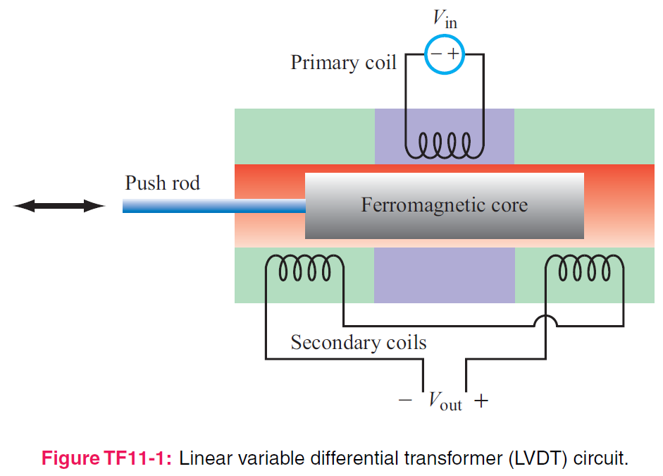
5. Magnetostatics
7e Applied EM by Ulaby and Ravaioli

Slide 2
Chapter 5 Overview

Slide 3
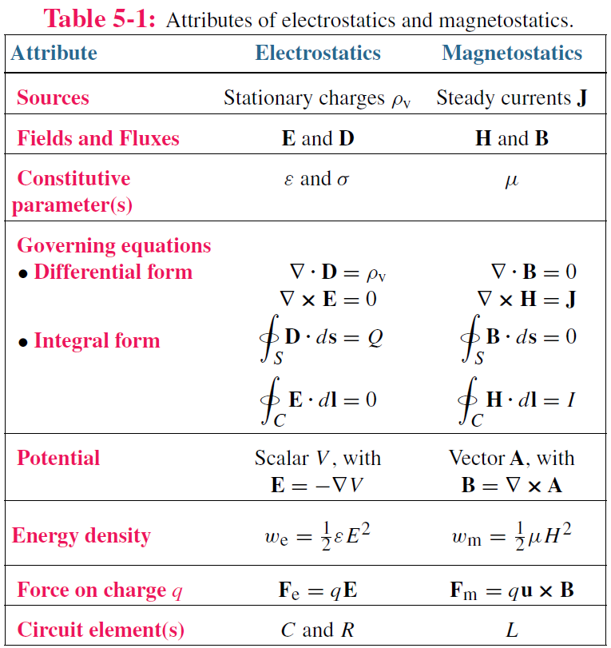
Electric vs Magnetic Comparison

Slide 4
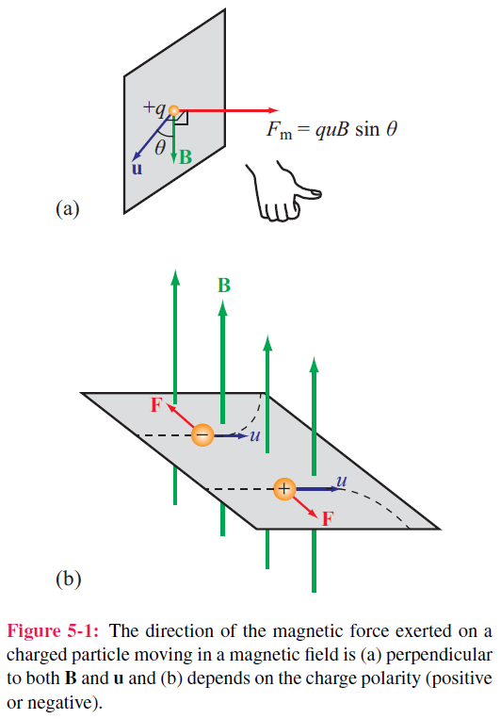

Electric & Magnetic Forces
Magnetic force
Electromagnetic (Lorentz) force
Three differences between F_{e} and F_{m}

Slide 5
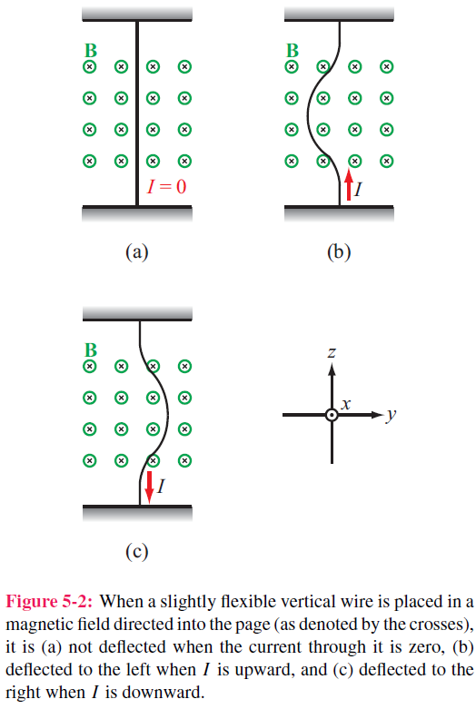
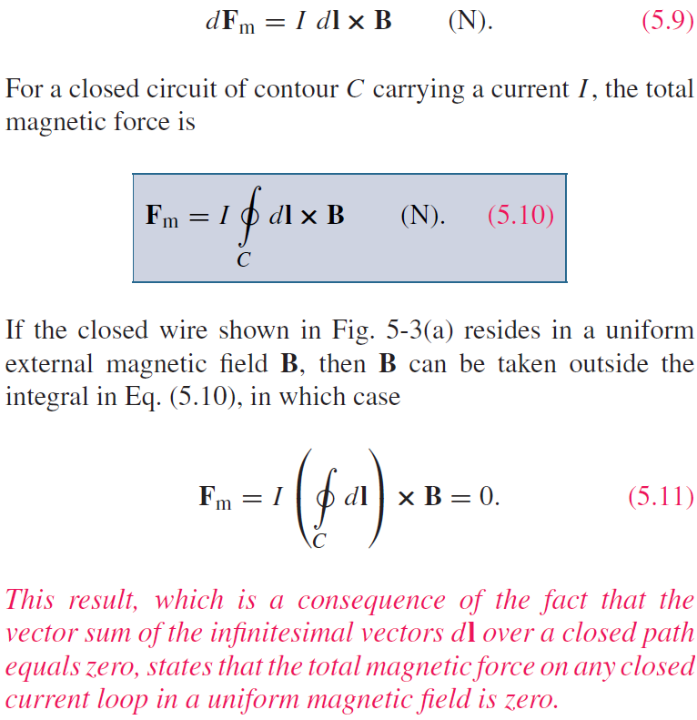
Magnetic Force on a Current Element
Differential force dFm on a differential current I dl:

Slide 6
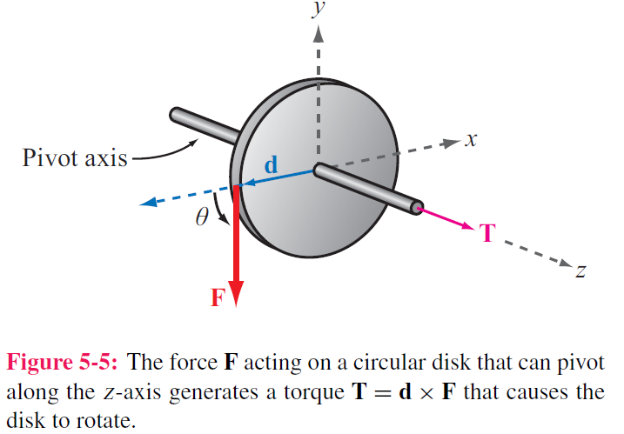

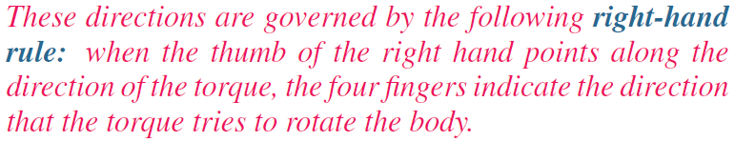
Torque
d = moment arm
F = force
T = torque

Slide 7
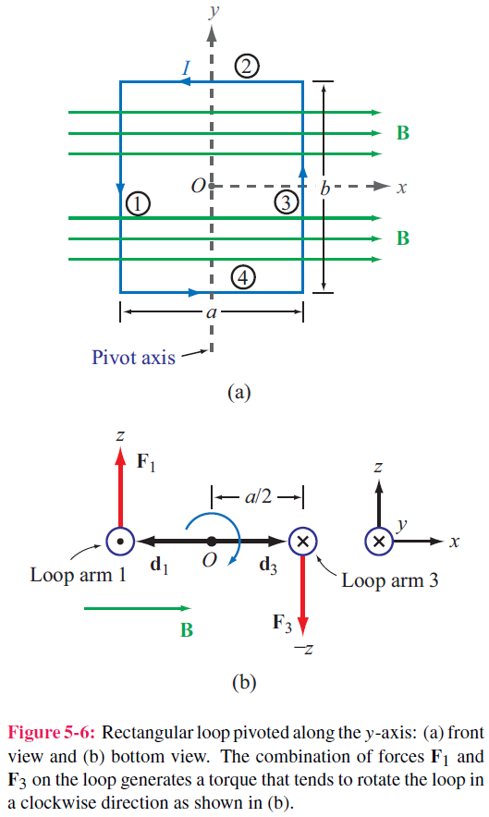
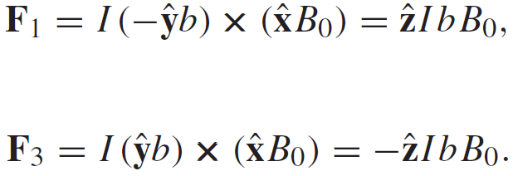
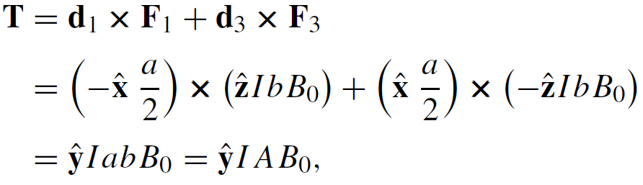
Magnetic Torque on Current Loop
No forces on arms 2 and 4 ( because I and B are parallel, or anti-parallel)
Magnetic torque:
Area of Loop

Slide 8
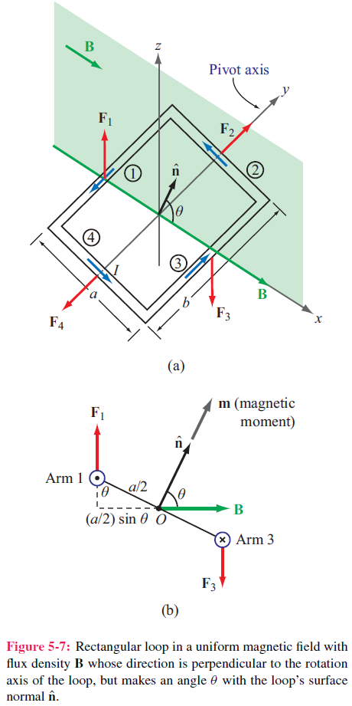
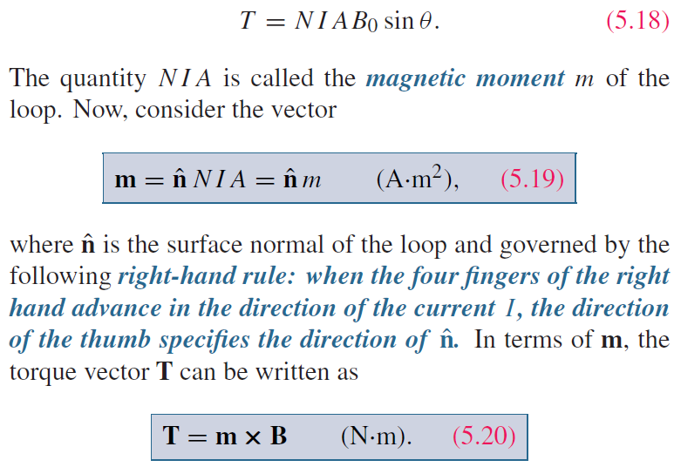
Inclined Loop
For a loop with N turns and whose surface normal is at angle theta relative to B direction:

Slide 9
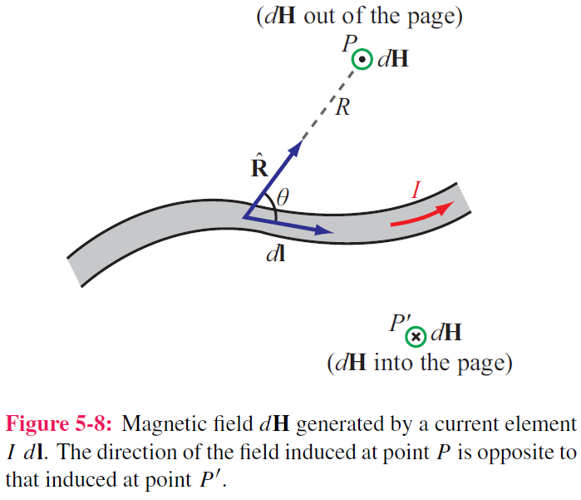

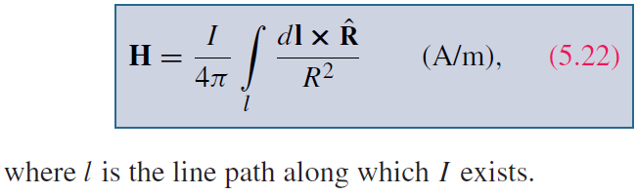
Biot-Savart Law
Magnetic field induced by
a differential current:
For the entire length:

Slide 10
Magnetic Field due to Current Densities

Slide 11
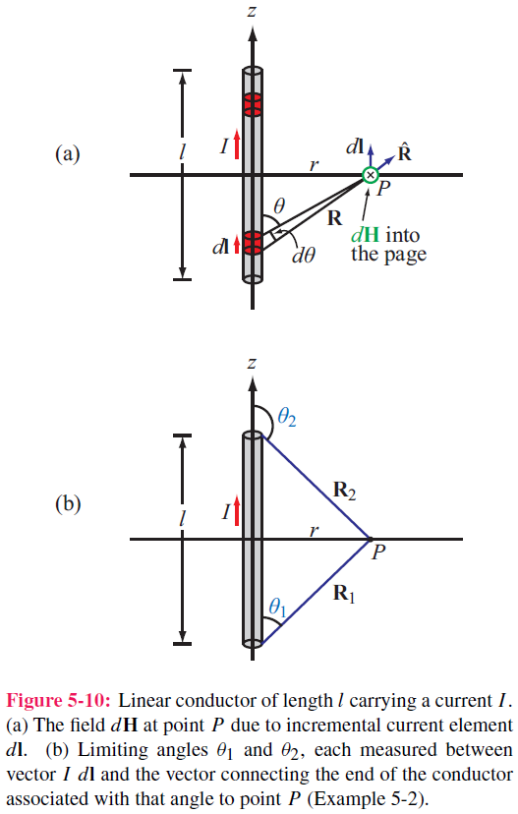
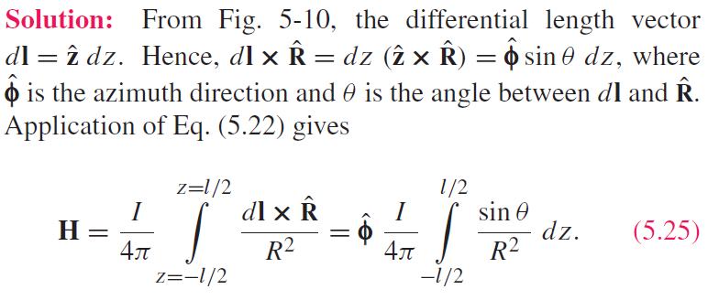
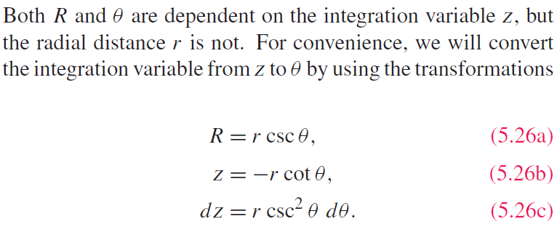
Example 5-2: Magnetic Field of Linear Conductor
Cont.

Slide 12
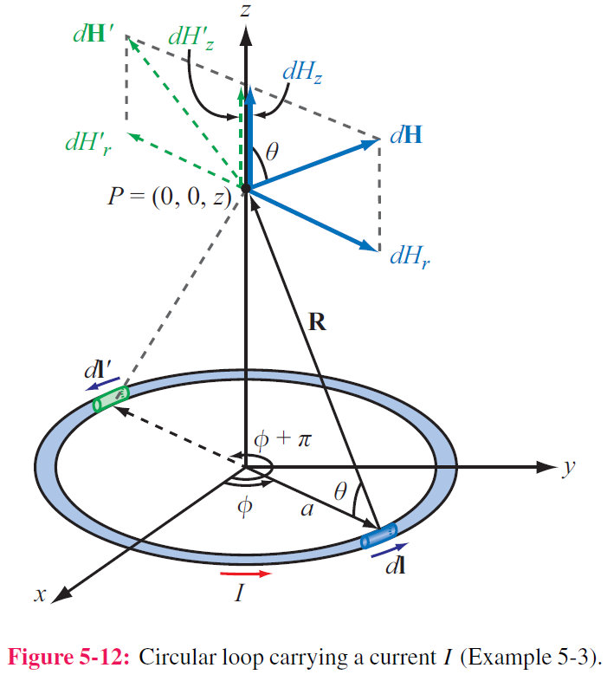
Example 5-3: Magnetic Field of a Loop
Magnitude of field due to dl is
dH is in the r–z plane , and therefore it has
components dHr and dHz
z-components of the magnetic fields due to dl and dl’ add because they are in the same direction,
but their r-components cancel
Hence for element dl:
Cont.

Slide 13
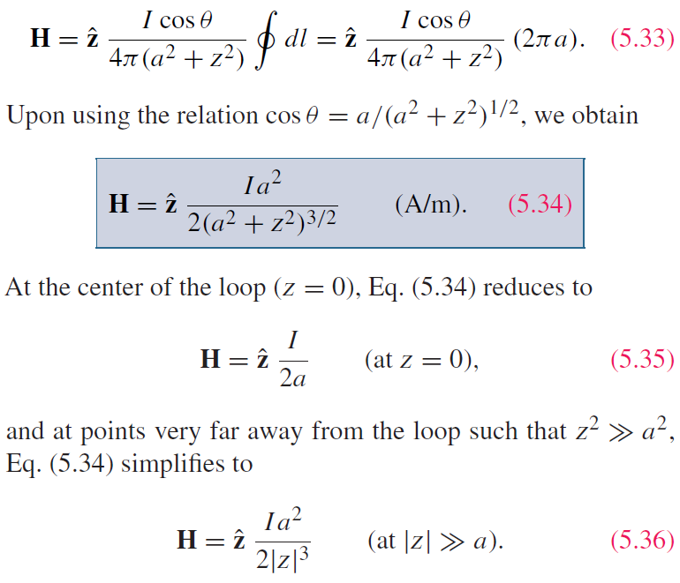
Example 5-3:Magnetic Field of a Loop (cont.)
For the entire loop:

Slide 14
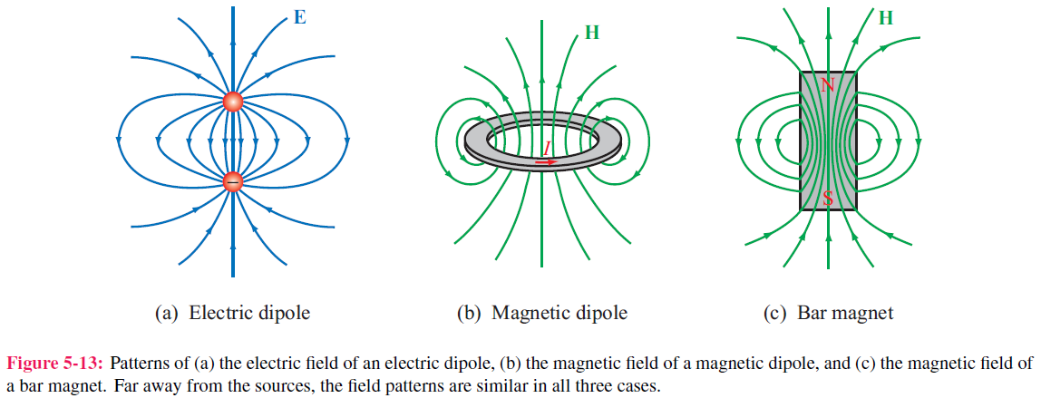
Magnetic Dipole
The dimension of the dipole is much smaller than the distance where you want to evaluate its field
Because a circular loop exhibits a magnetic field pattern similar to the electric field of an electric dipole, it is called a magnetic dipole

Slide 15
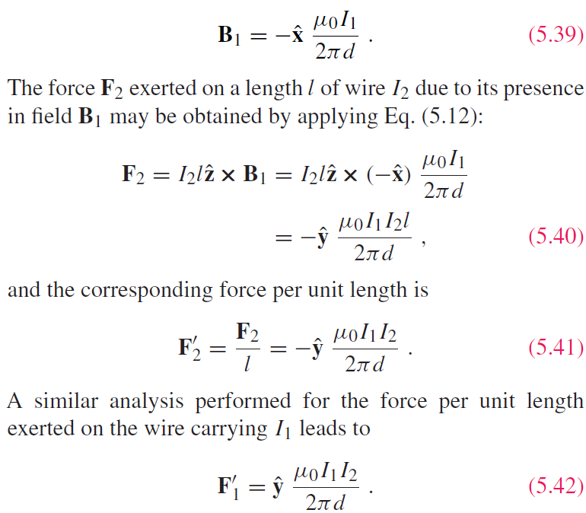
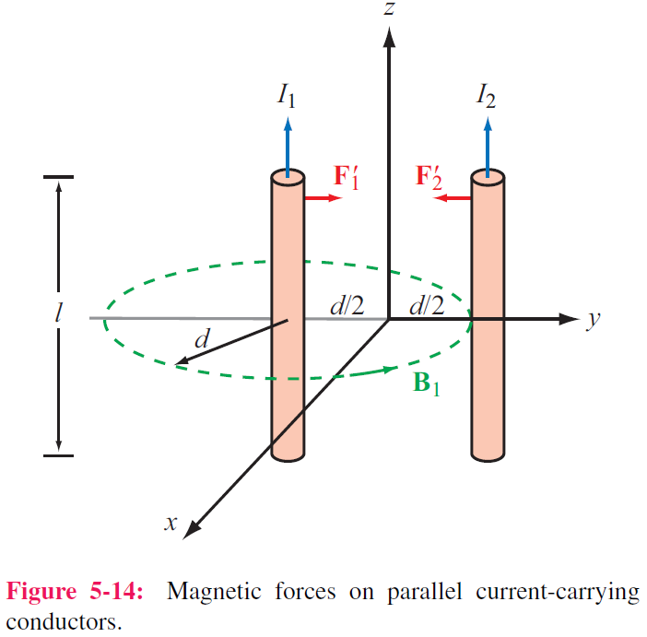
Forces on Parallel Conductors
Parallel wires attract if their currents are in the same direction, and repel if currents are in opposite directions

Slide 16
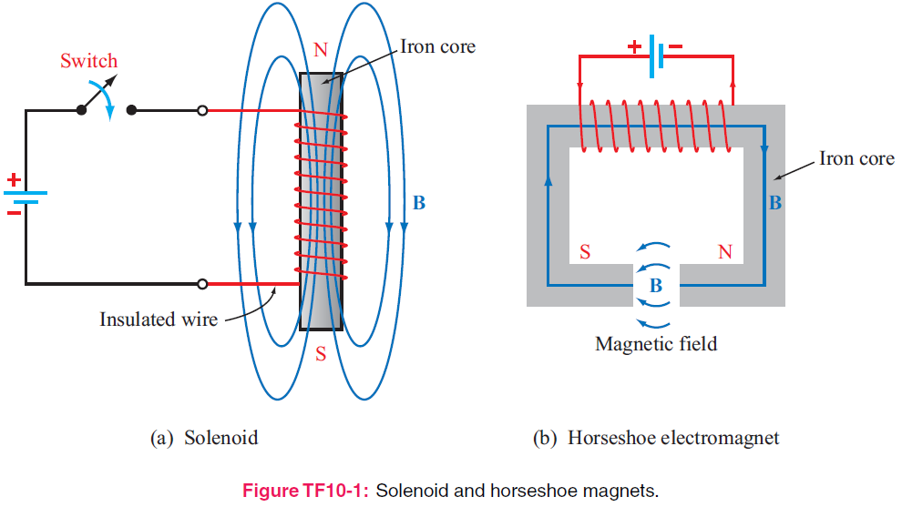
Tech Brief 10: Electromagnets

Slide 17
Gauss’s Law for Magnetism
Gauss’s Law for Electricity
Gauss’s Law for Magnetism
No magnetic monopole
Magnetostatics
Electrostatics
Always Closed

Slide 18
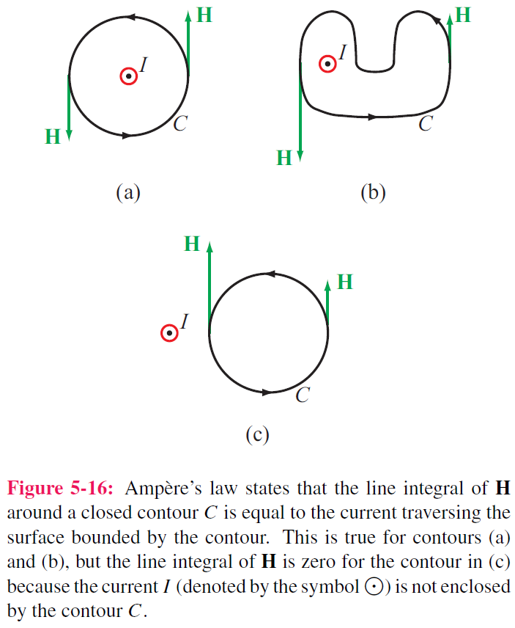
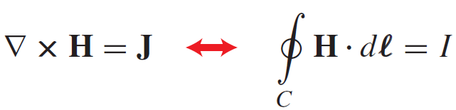
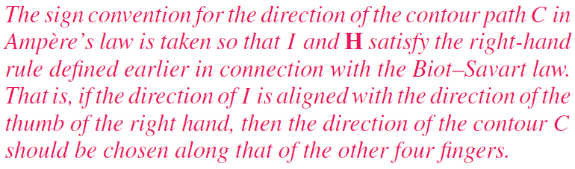
Ampère’s Law
Conservative
Not Conservative

Slide 19
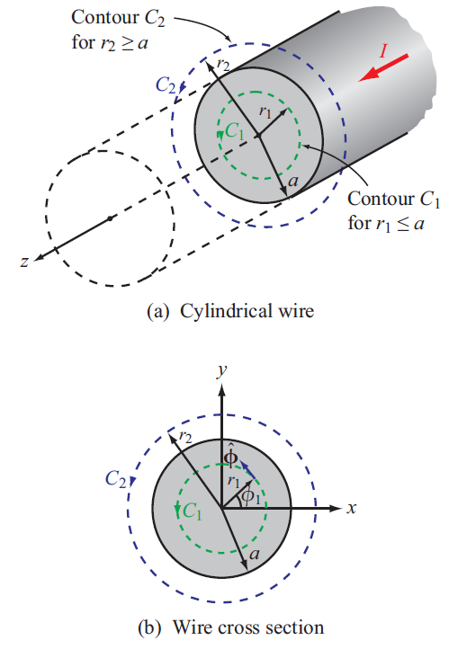
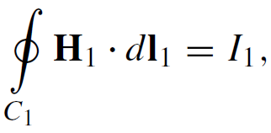
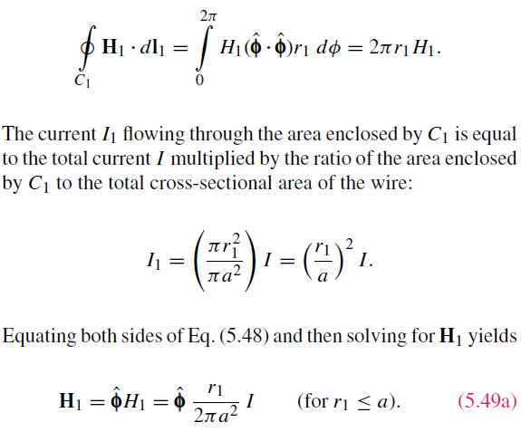
Internal Magnetic Field of Long Conductor
For r < a
Cont.

Slide 20
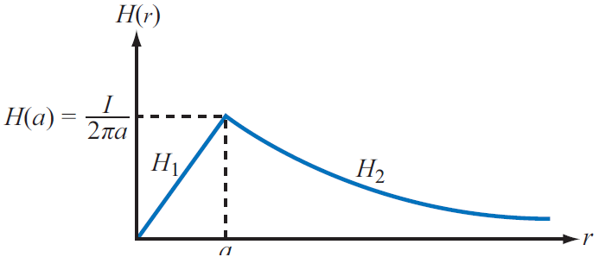
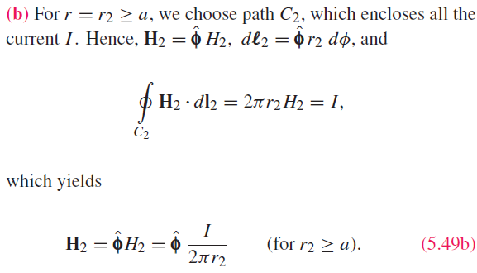
External Magnetic Field of Long Conductor
For r > a

Slide 21
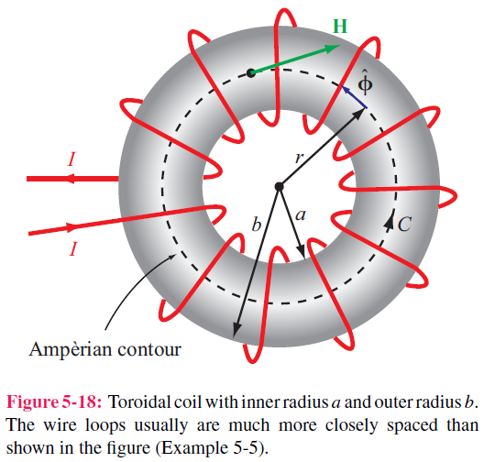
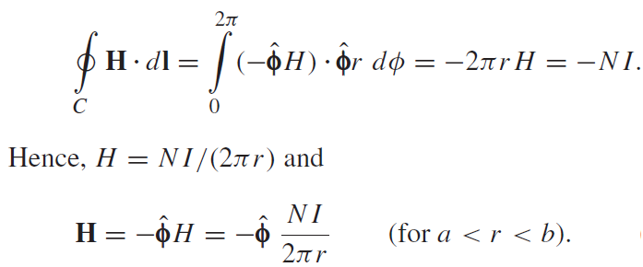
Magnetic Field of Toroid
Applying Ampere’s law over contour C:
Ampere’s law states that the line integral of H around a closed contour C is equal to the current traversing the surface bounded by the contour.
The magnetic field outside the toroid is zero. Why?

Slide 22
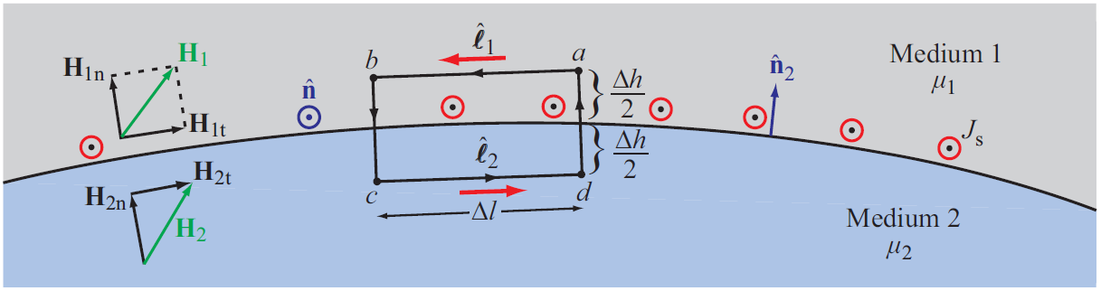
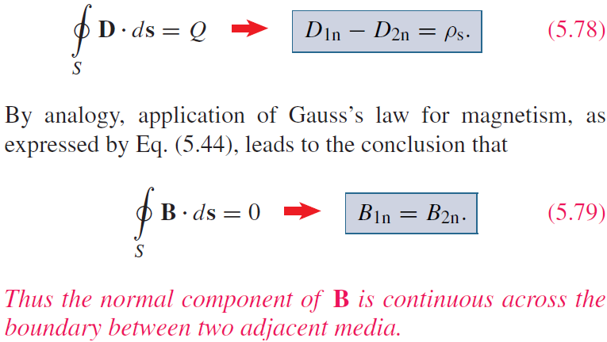
Boundary Conditions

Slide 23

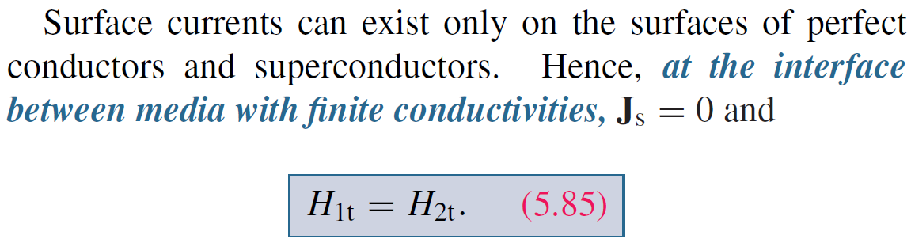




Boundary Conditions
$$∆h→0$$

Slide 24
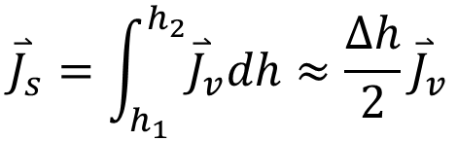
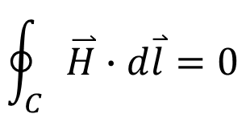
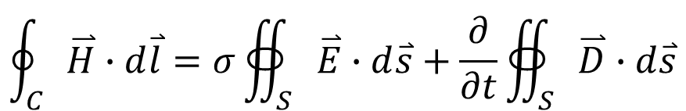
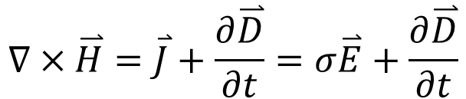



Boundary Condition for Finite σ
$$∇×\overset{⃑}{H}=\overset{⃑}{J}+\frac{∂\overset{⃑}{D}}{∂t}=σ\overset{⃑}{E}+\frac{∂\overset{⃑}{D}}{∂t}$$
$${\overset{⃑}{J}}_{s}=\int_{h_{1}}^{h_{2}}{{\overset{⃑}{J}}_{v}dh}≈\frac{∆h}{2}{\overset{⃑}{J}}_{v}$$
$$\oint_{C}{\overset{⃑}{H}∙d\overset{⃑}{l}}=σ∯_{S}{\overset{⃑}{E}∙d\overset{⃑}{s}}+\frac{∂}{∂t}∯_{S}{\overset{⃑}{D}∙d\overset{⃑}{s}}$$
$$∆h→0$$
$$\oint_{C}{\overset{⃑}{H}∙d\overset{⃑}{l}}=0$$
$${\overset{⃑}{J}}_{s}=0$$
$$∆h→0$$
Continuous

Slide 25
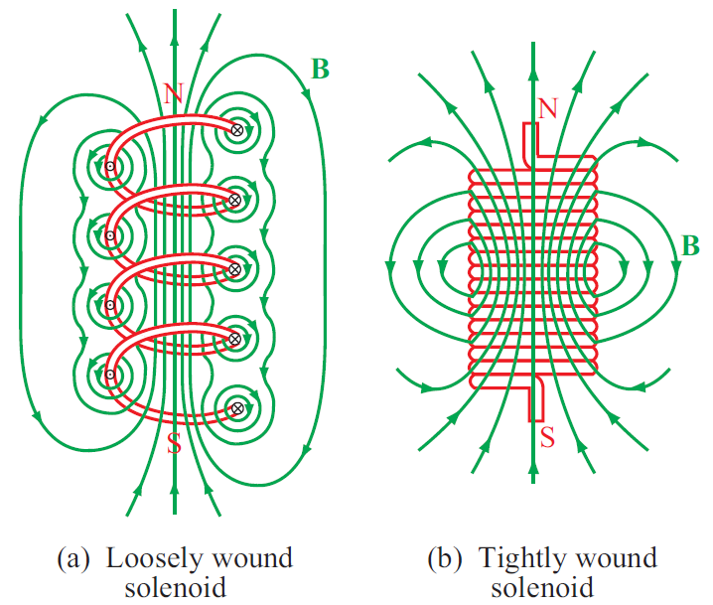
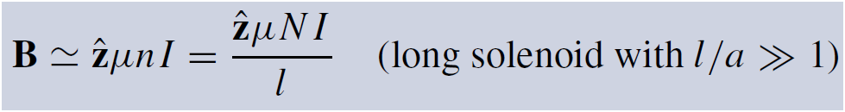
Solenoid
Inside the solenoid:

Slide 26
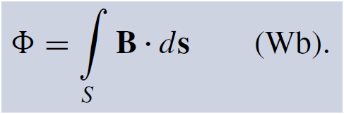
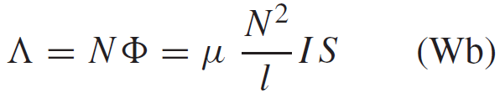
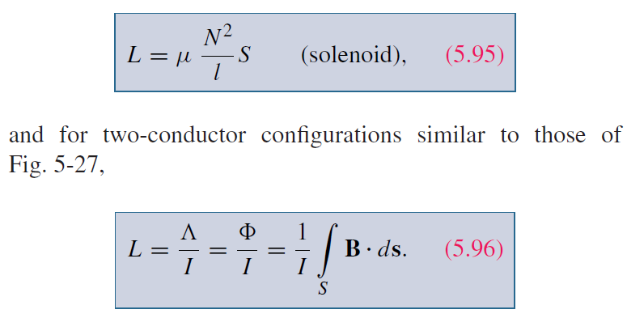
Inductance
Magnetic Flux
Flux Linkage
Inductance
Solenoid

Slide 27
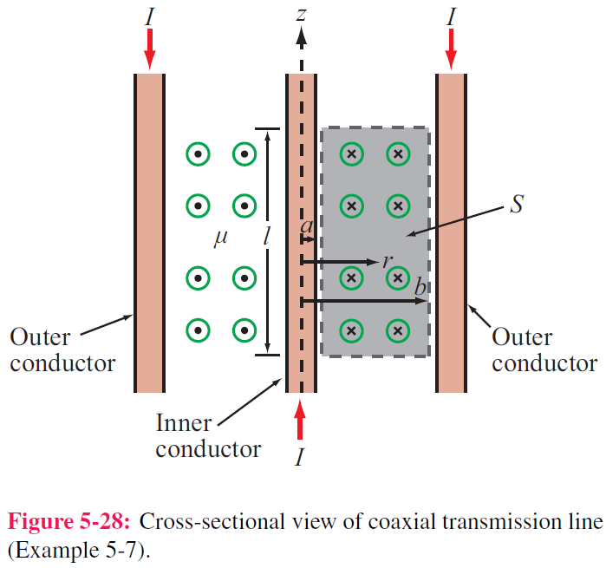
Example 5-7: Inductance of Coaxial Cable
The magnetic field in the region S between the two conductors is approximately
Total magnetic flux through S:
Inductance per unit length:

Slide 28
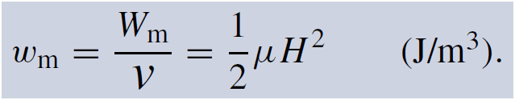
Magnetic Energy
Magnetic field in the insulating material is
The magnetic energy stored in the
coaxial cable is

Slide 29
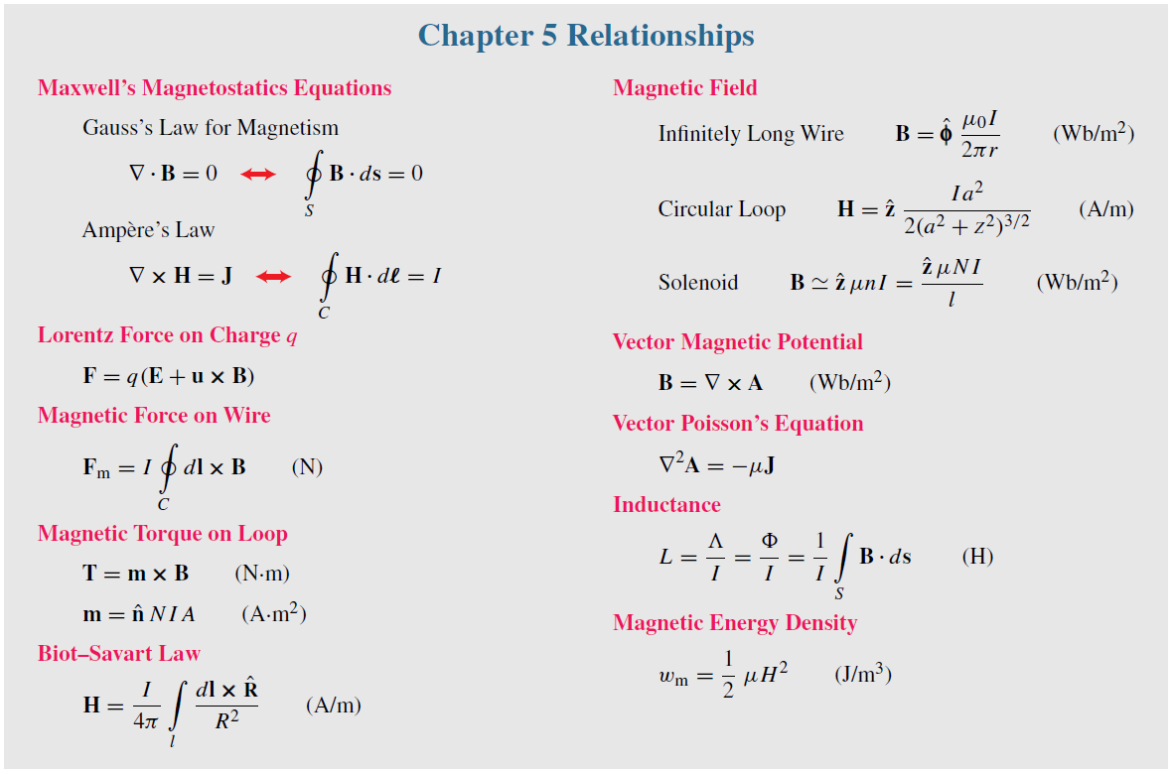
Summary

